Slide 1
A Comparative Study of Signaling Protocols for Data Management and Synchronization
#Department of Computer Engineering, Kocaeli University

Slide 2
Introduction
In these study signaling protocols such as XMPP, SIP and ARCSPXP are reviewed and compared for their feasibility of employing in school level proxy server based architecture.
In the proposed system, the same data (files) can be placed in three different tiers. These tiers can be listed as;
Cloud layer
Proxy server layer
Tablets

Slide 3
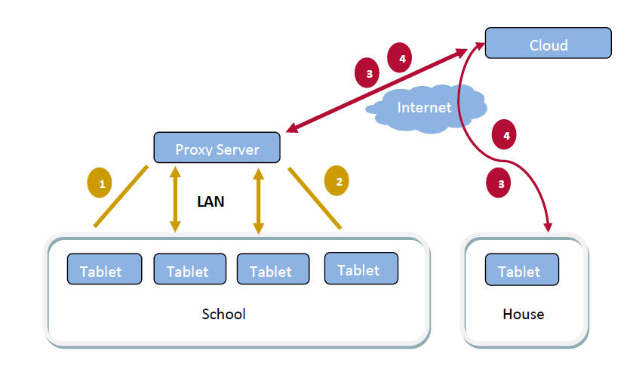
Overview of the System
Figure 1 Architecture of proposed synchronization system
Notes:
We propose to employ school level proxy server in Fatih project ecosystems as shown in Fig. 1 In current architecture, Tablets at school or home involve communication with cloud server. By installing a proxy at school, overall system becomes manageable and scalable, and overall network traffic can be decreased. However, such an architecture requires an effective synchronization protocol to achieve the followings:

Slide 4
Signalling Methods
We handled three different signalling methods within the context of project. These methods are;
XMPP
SIP
ARCSPXP
Notes:
In our study, a signaling protocol that provides connection mechanism and synchronization between tablet-proxy. In our study, signaling protocols such as XMPP, SIP and ARCSPX are reviewed and compared for their feasibility of employing school level proxy server based architecture.

Slide 5
XMPP
XMPP is an , is an XML based signaling protocol for message oriented middleware.
It enables two endpoints on the Internet to mutually transfer any structural information.
It allows message, file, and status transfer among more than one unit.
Notes:
XMPP originally named as Jabber, is an XML based signaling protocol for message oriented middleware. It enables two endpoints on the Internet to mutually transfer any structural information. Also, it allows message, file, and status transfer among more than one unit. Although XMPP is first intended for instant messaging, its XMPP has been improved for larger systems such as cloud computing .

Slide 6
SIP
SIP is a signaling protocol which creates, set up and finishes VOIP phone calls .
It has a text-based message structure and defines messages.
Besides being a text-based, SIP is also http-like protocol.
SIP can be used in many areas.
Notes:
SIP is a signaling protocol which creates, set up and finishes VOIP phone calls and has a text-based message structure. Besides being a text-based, SIP is also like http- protocol. Its messages are similar to http messages. SIP defines messages which will be sending between couples during a call. Also SIP can be used in many areas such as; video conferences, fax transmission, file transfer and transferring status information .

Slide 7
ARCSPXP
ARCSPXP is a protocol developed by ArdicTech.
ARCSPXP is an optimized signaling protocol.
It is facilitating communication between “client-to-server” and “server-to-server” and monitoring the connection between the client-server.
Notes:
ARCSPXP is a protocol developed by ArdicTech for facilitating communication between “client-to-server” and “server-to-server” and monitoring the connection between the client-server. ARCSPXP is an optimized signaling protocol that is specialized to mobile devices which are communicating with cloud based services via its internet connection.

Slide 8
ARCSPXP
ARCSPXP protocol deals with three level result of a process. These are;
Real delivery of the message to the end-point
Start of task
Completion of the task
Notes:
ARCSPXP protocol deals with three level result of a process. First level result is related to real delivery of the message to the end-point. Second level result is related to start of task and third level result is related to completion of the task.

Slide 9
Evaluation of Signalling Protocols
ARCSPXP signaling protocol has a significant difference about the semantic structures and functional messaging.
XMPP and SIP protocols are general purposed protocols and these protocols try to solve the security problems.
ARCSPXP provides a more manageable and easy to use integration structure for mobile devices
Notes:
If we compare the semantic structures and functional messaging background of protocols, ARCSPXP signaling protocol has a significant difference.
This difference provides flexibility to ARCSPXP protocol's for expanding message scale. In addition to supporting functionalities of SIP and XMPP, ARCSPXP also provides enhanced security solution with Authentication, Authorization, and Accounting support. ARCSPXP provides a more manageable and easy to use integration structure for mobile devices. SIP protocol is specialized in audio/video communication. XMPP has better message support for instant messaging and state communication.

Slide 10
Evaluation of Signalling Protocols
ARCSPXP cares about the lifecycle of message and related task that we want to monitor.
ARCSPXP has ability to deliver the same message to multiple clients with structured data types using streaming structure.
It provides decreasing bandwidth usage at server side by up to 14%.
Notes:
ARCSPXP cares about the lifecycle of message and related task that we want to monitor. ARCSPXP has ability to deliver the same message to multiple clients with structured data types using streaming structure. ARCSP-XP signaling protocol has a significant difference. It can provide reduction at bandwidth usage with the properties provided at client - server communication.

